Slide 1

Girl Power in Engineering and IT
Introduction to Micro:bits in Python

Slide 2
Tutors!

Slide 3

Women in tech: The First Programmer
Augusta Ada King, Countess of Lovelace
English mathematician and writer
She wrote the very first computer program!
Worked with the mathematician Charles Babbage on his mechanical general-purpose computer, the Analytical Engine.
It was a mechanical calculator
Lovelace created an algorithm to calculate the Bernoulli numbers.
It doesn’t end here…
Intro to microbits - Girl Power Camp

Slide 4
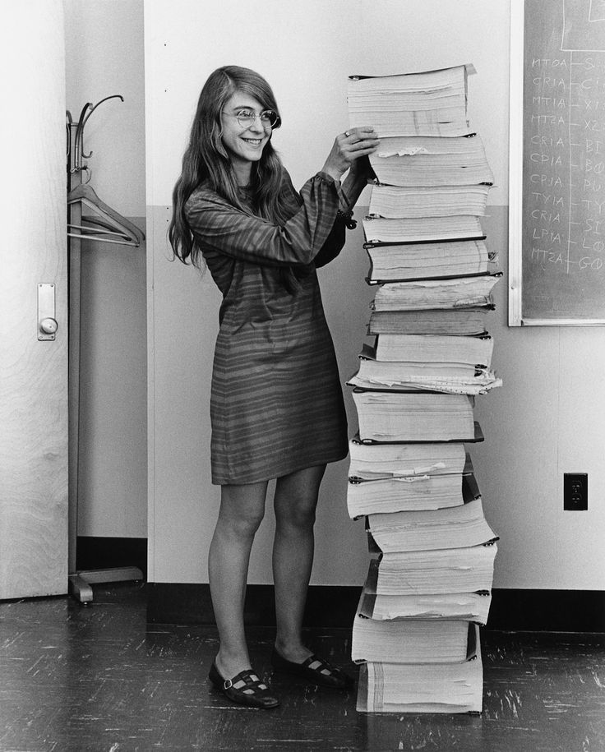
Women in tech: The First Software Engineer
Margaret Elaine Hamilton
American computer scientist, systems engineer and business owner
She invented the term ‘software engineering’
Worked on NASA’s Apollo program (more like saved)
She created a program that identifies what ‘an important task’ is, and when the system gets too many messages, it only does the important ones!
Intro to microbits - Girl Power Camp

Slide 5
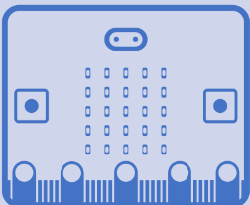

Outline
What is a micro bit? Where do we use it?
Setting up your environment and micro:bit
Intro to Python
Programming a micro:bit
Intro to microbits - Girl Power Camp

Slide 6
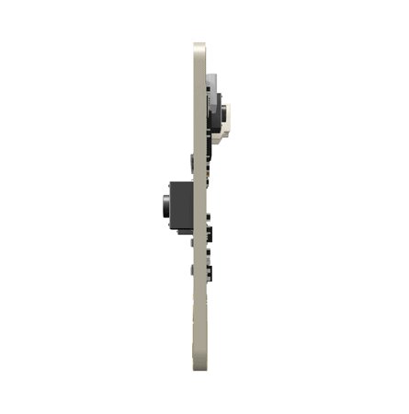
What is a Micro:bit?
It is a board of lights tiny lights, called pixels
It is used to create patterns and pictures
What is an example of a big Micro:bit??
Intro to microbits - Girl Power Camp

Slide 7

Setting up your environment on microbit.org
Your own online editor specifically for microbits!

Slide 8
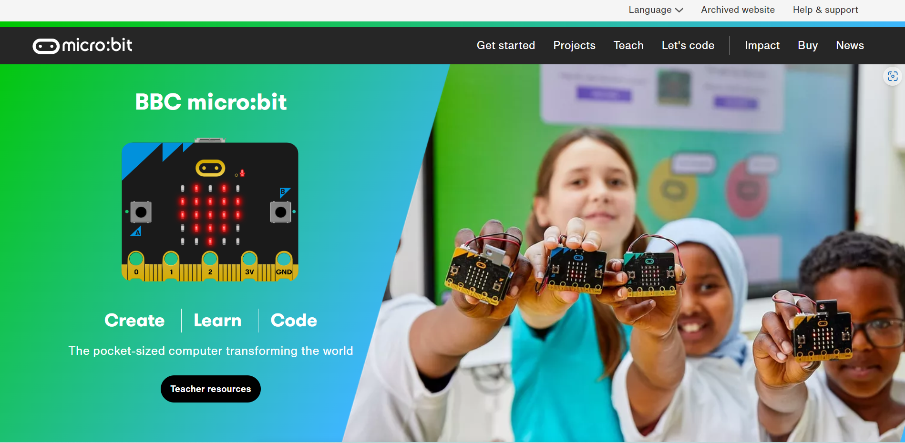

Slide 9
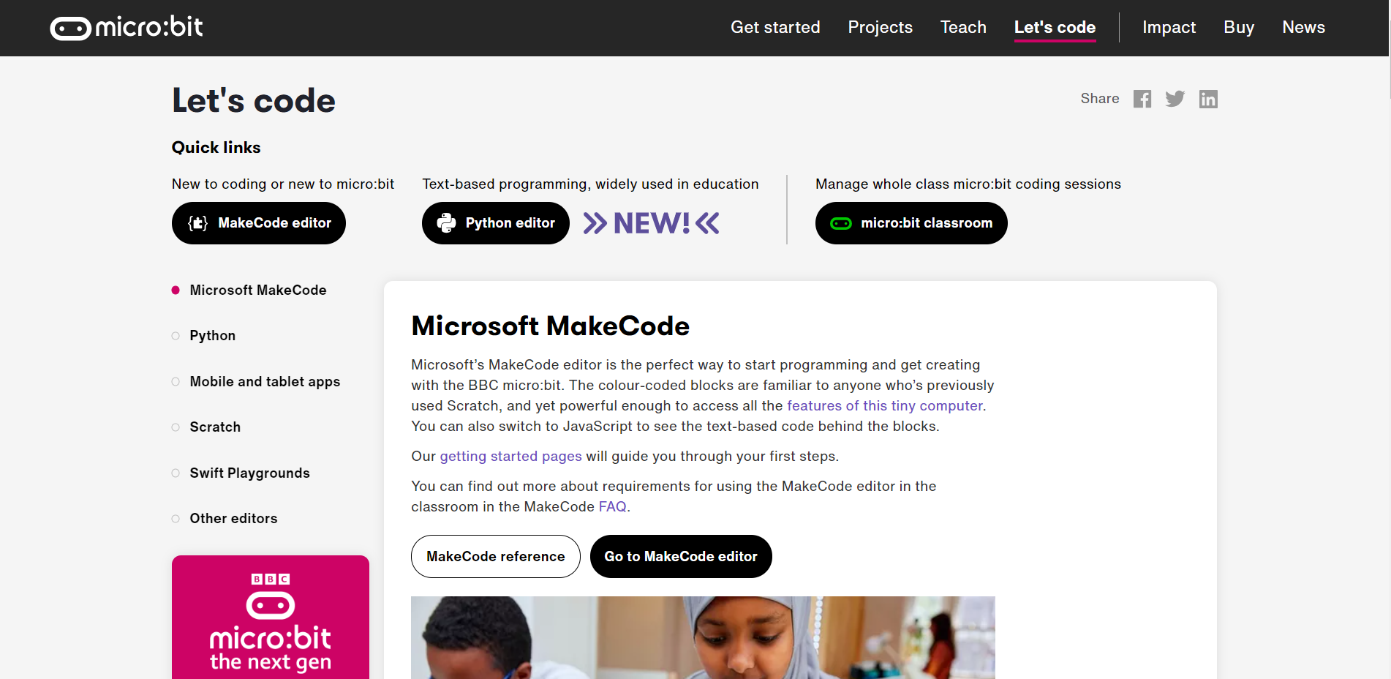

Slide 10
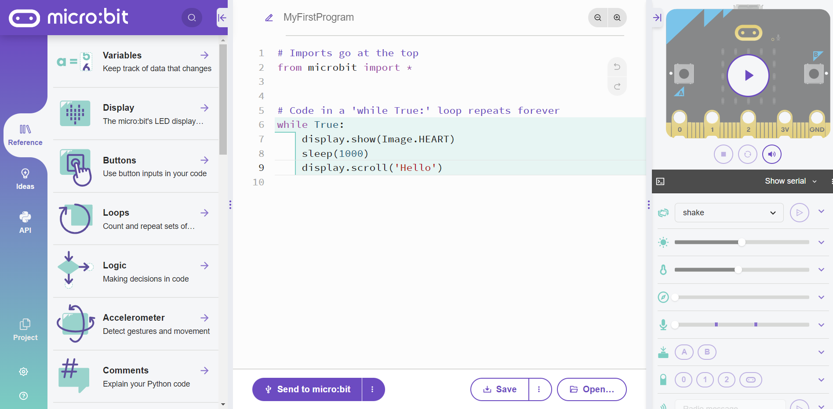
NAME
SIMULATOR
CODE GOES HERE
RUN
LOCAL

Slide 11
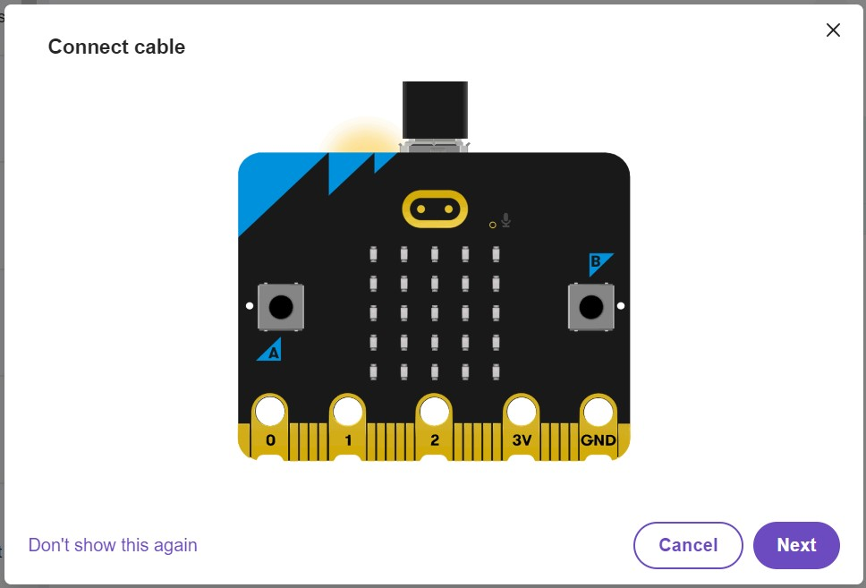
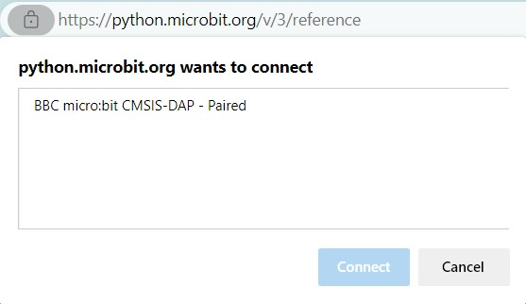
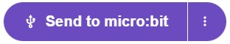
Connecting your microbit
To use a physical microbit, you need to connect it to your digital environment!
Find this button
Plug in your microbit
Connect to your digital environment
Intro to microbits - Girl Power Camp

Slide 12

Python
A quick intro

Slide 13
Python is a programming language
It is used to communicate with a computer
We provide a set of instructions to the computer in python!
It is not the only language out there
We use it because it is simple, and serves the intended purpose
Intro to microbits - Girl Power Camp

Slide 14
What is a library?
In programming we have a thing called a library
A library is like a piece of code that performs tasks for us
Today, we will use the microbit library!
from microbit Import *
Star means ‘all’
The above line is saying, import all the code from the library called ‘microbit’
Intro to microbits - Girl Power Camp

Slide 15
Part 1: Images and Text

Slide 16
Start with a smile!
Type the following line into your editor
display.show(Image.HAPPY)
Press “Send to microbit”. Remember, this is where you can find it:
What do you see :)
Intro to microbits - Girl Power Camp

Slide 17
Object
Method
Argument
display.show(Image.Happy)
Intro to microbits - Girl Power Camp

Slide 18
Is that it!?
Try these commands:
display.show(Image.DUCK)
then
display.show(Image.ARROW_N)
then
display.show(Image.ARROW_S)
What do you see!?
Intro to microbits - Girl Power Camp

Slide 19
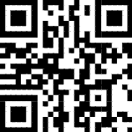
The full list
Images — BBC micro:bit MicroPython 1.1.1 documentation (microbit-micropython.readthedocs.io)
https://tinyurl.com/mr3rszy3
Intro to microbits - Girl Power Camp

Slide 20


Two in a row
Try doing the following:
display.show(Image.ARROW_N)
display.show(Image.ARROW_S)
What do you see?
Intro to microbits - Girl Power Camp

Slide 21

Not happy… I want both :(
The problem is that our program is too fast
We need to get our program to pause between the two images.
The way to do that is to use the statement:
sleep(milliseconds)
And we replace ‘milliseconds’ with a number. 1 second = 1000 ms
Intro to microbits - Girl Power Camp

Slide 22
Phew!
Try the following code:
display.show(Image.ARROW_N)
sleep(1000)
display.show(Image.ARROW_S)
What does this code do?
Intro to microbits - Girl Power Camp

Slide 23
Say something
When we want to say something in python, we use
print(“Hello!”)
But for a microbit, we use
display.scroll(“Hello!”)
Notice that print() will throw an error
Intro to microbits - Girl Power Camp

Slide 24
Combination
What if we want to display text and an image?
This is done as follows:
display.scroll(“Hello!”)
display.show(Image.HEART)
Intro to microbits - Girl Power Camp

Slide 25
Part 2: While loops

Slide 26
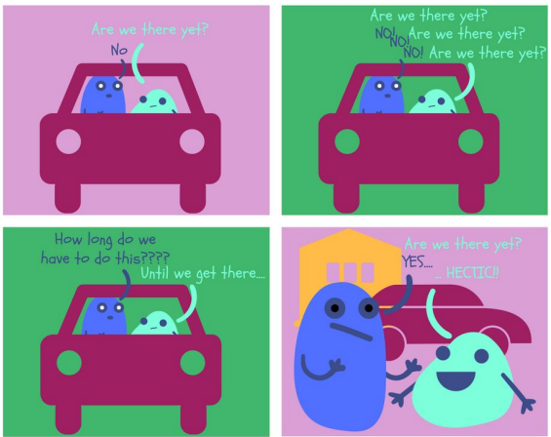
What if I don’t want my code to stop?
We know how to do things on repeat!
Sometimes we want some code to repeat!
Intro to microbits - Girl Power Camp

Slide 27

What do you think the following code does?
while True:
display.show(Image.GIRAFFE)
sleep(1000)
display.clear()
sleep(1000)
Intro to microbits - Girl Power Camp

Slide 28
Let’s take a closer look
Show a giraffe for 1 second, clear the display for 1 second. Then repeat
while True:
display.show(Image.GIRAFFE)
sleep(1000)
display.clear()
sleep(1000)
Loop condition
Code to repeat
Intro to microbits - Girl Power Camp

Slide 29
Part 3: Buttons and If Statements

Slide 30
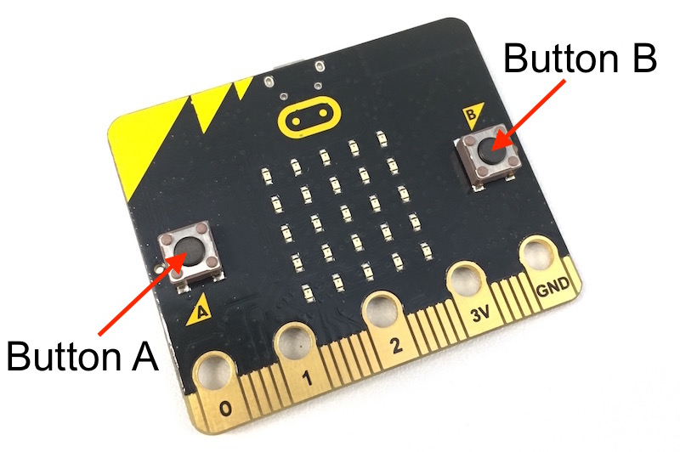
Buttons on a microbit
Grok, BBC micro:bit Crash Course

Slide 31
Buttons on a microbit
The microbit library considers these two buttons as two objects:
button_a
button_b
They are objects just like display
But they have different methods:
button_a.is_pressed() checks if button a has been pressed
Intro to microbits - Girl Power Camp

Slide 32
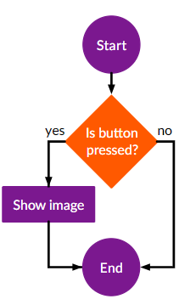
If I press a button, an image appears
An if statement has the following syntax:
if condition is true:
do this
and this
Example:
if button_a.is_pressed():
display.show(Image.DUCK)
Intro to microbits - Girl Power Camp

Slide 33
Why can’t we see it?
The program is too fast
Not enough time for us to press the button
I want my program to run forever… what do I use?
A while loop! Try the following:
while True:
if button_a.is_pressed():
display.show(Image.DUCK)
Intro to microbits - Girl Power Camp

Slide 34
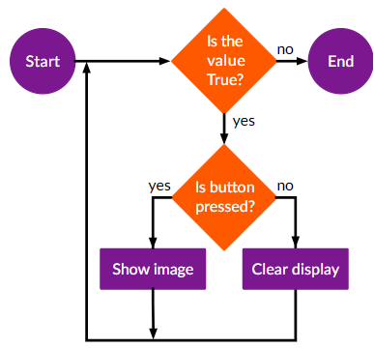
Well not forever…
The duck now doesn’t disappear at all.
We want to see the duck only when we’re pressing the button.
We should add another condition.
Intro to microbits - Girl Power Camp

Slide 35
if-else statement
If this is true
Do this
while True:
if button_a.is_pressed():
display.show(Image.DUCK)
else:
display.clear()
Otherwise
Do this
Intro to microbits - Girl Power Camp

Slide 36
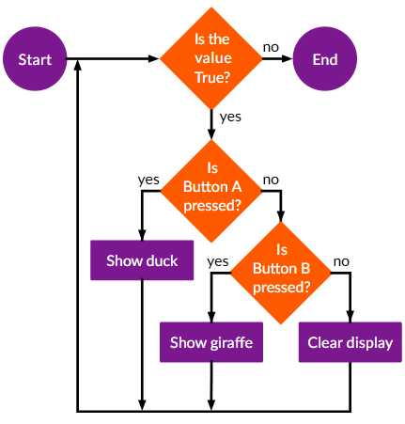



More conditions!
If we press A, we want a duck
If we press B, we want a giraffe
Otherwise, clear!
Intro to microbits - Girl Power Camp

Slide 37
If-elif-else statements, when will this be over…
When we have multiple conditions, we use an elif statement
It has the following structure
if this is true:
do this
elif the previous is not true, and this is true:
do this
else
do this
Intro to microbits - Girl Power Camp

Slide 38
Part 4: Music

Slide 39
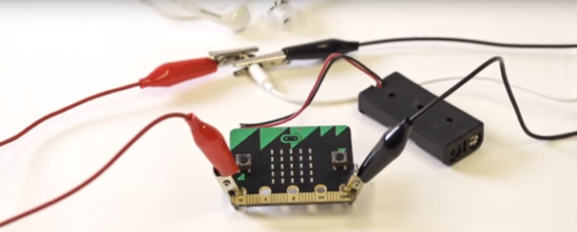
Connecting your headphones
https://makecode.microbit.org/projects/hack-your-headphones/make
Intro to microbits - Girl Power Camp

Slide 40
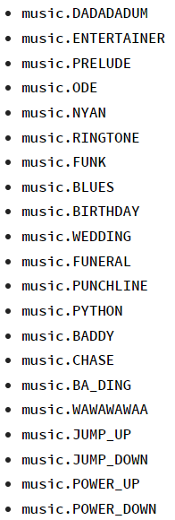
The magical statement
What’s this?
import music
music.play(music.[song])
Example:
music.play(music.ODE)
music.play(music.CHASE)
Intro to microbits - Girl Power Camp

Slide 41
Part 5: Pixels and Variables

Slide 42
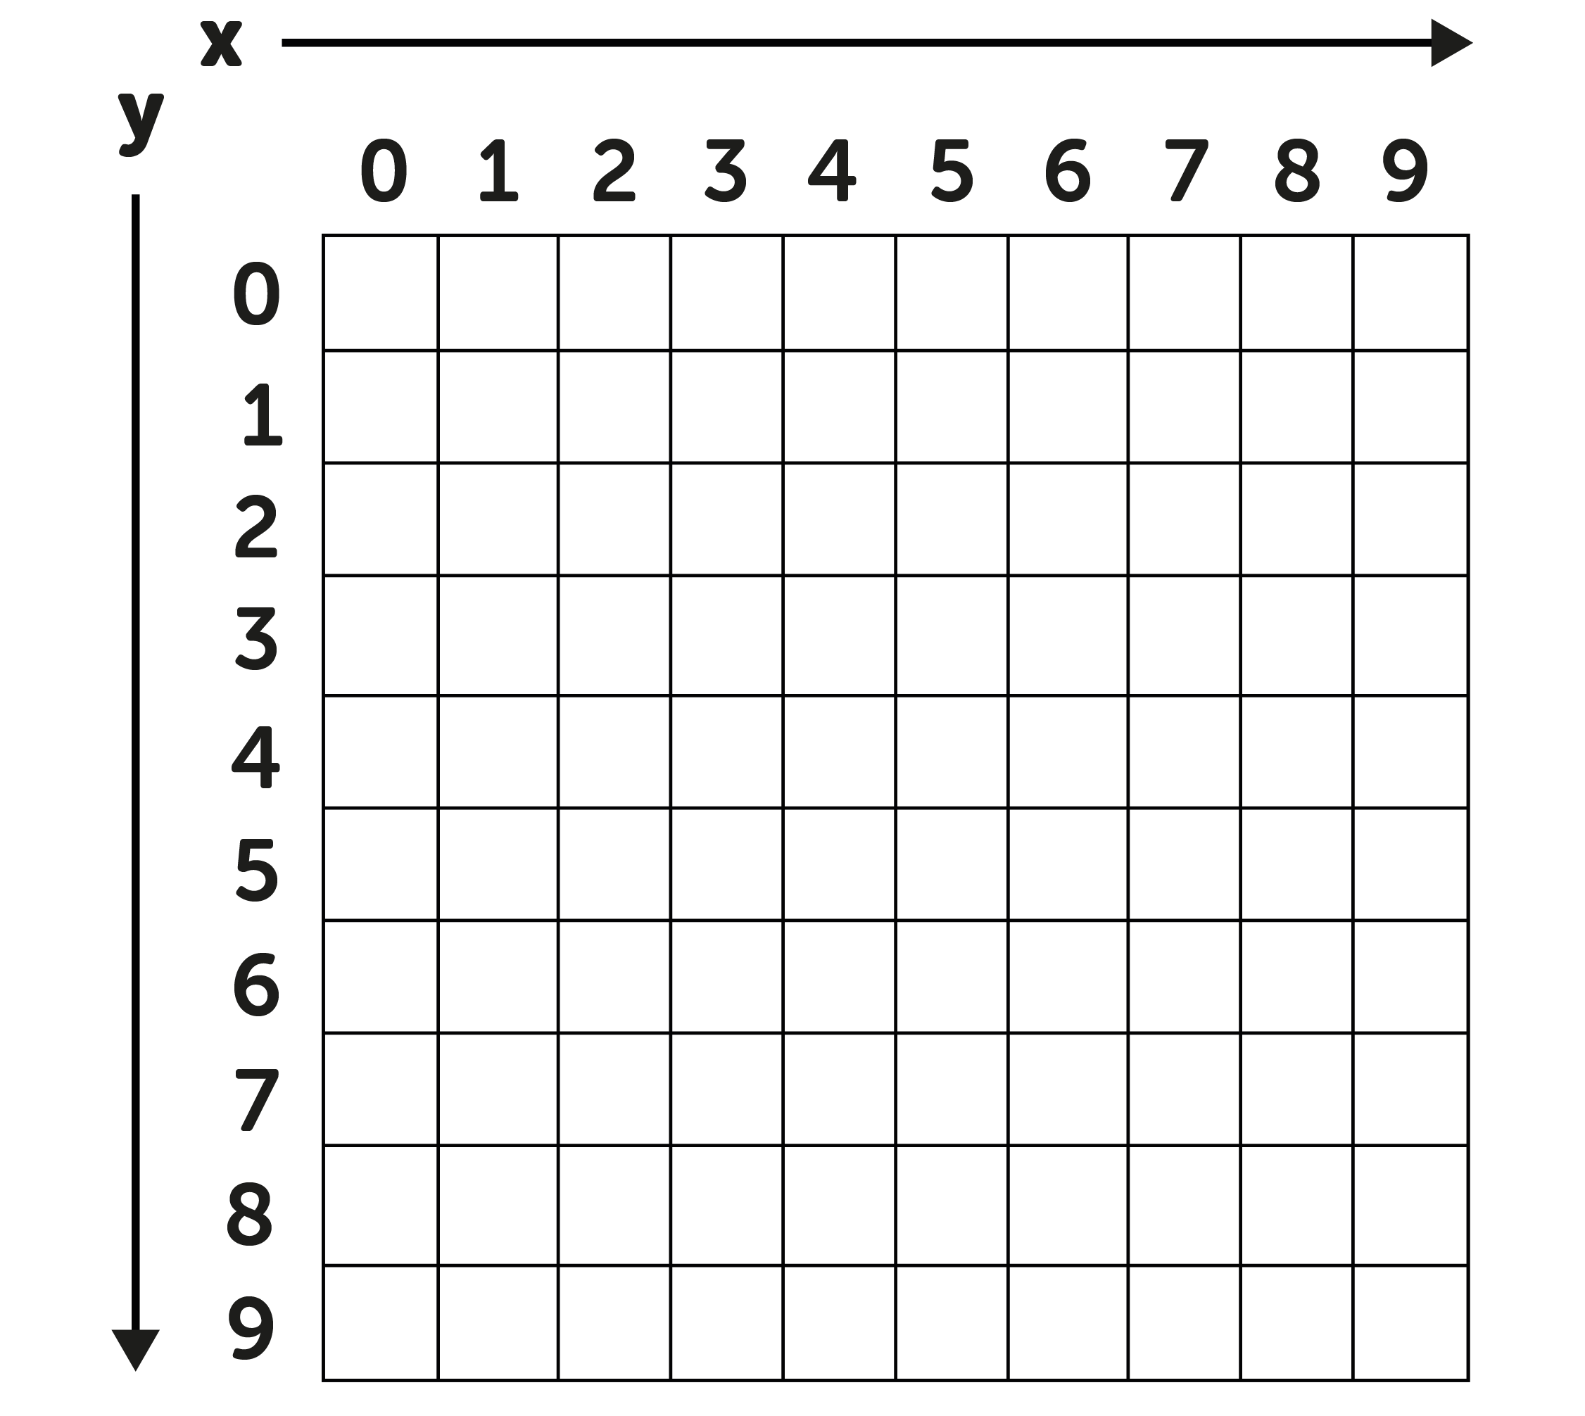
1 Pixel at a time
(1,0)
(4,5)
(8,7)
Intro to microbits - Girl Power Camp

Slide 43
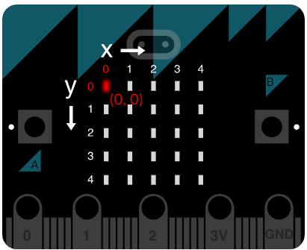

Slide 44
Light up a single pixel
display.set_pixel(x, y, brightness)
Brightness goes from 0 to 9, with 9 being the highest
Example:
display.set_pixel(0, 0, 9)
display.set_pixel(1, 1, 5)
Intro to microbits - Girl Power Camp

Slide 45
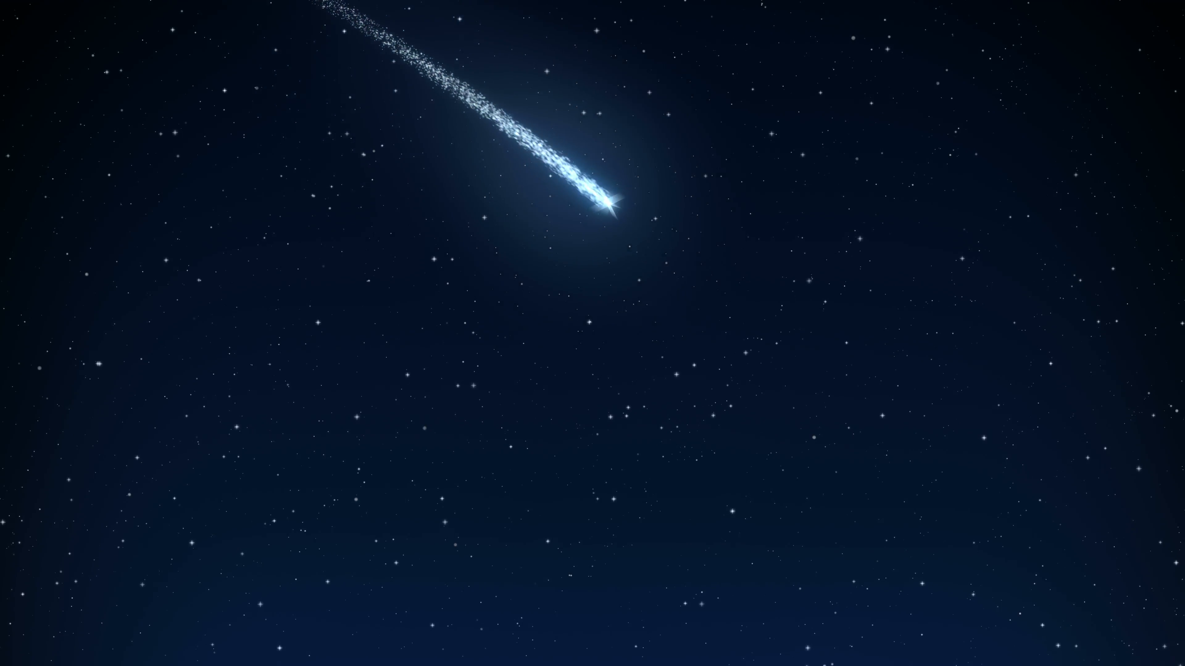
A falling star
Create a diagonal line, for which the brightness keeps increasing
display.set_pixel(0, 0, 1)
display.set_pixel(1, 1, 3)
display.set_pixel(2, 2, 5)
display.set_pixel(3, 3, 7)
display.set_pixel(4, 4, 9)

Slide 46

A dive into variables
A variable in python is like a box, that has a label, and contains something.
3
The box
Num = 3
Name = ‘Rama’
Num
Variable name
Value
Variable name
Value
Intro to microbits - Girl Power Camp

Slide 47
Rule #1: Don’t repeat yourself
Say you want to display a vertical line on a microbit. You use this code:
x = 0
display.set_pixel(x, 0, 9)
display.set_pixel(x, 1, 9)
display.set_pixel(x, 2, 9)
display.set_pixel(x, 3, 9)
This is so repetitive and boring!
Intro to microbits - Girl Power Camp

Slide 48

For loops
for y in range(5):
display.set_pixel(0, y, 9)
sleep(1000)
Intro to microbits - Girl Power Camp

Slide 49
Part 6: Counters

Slide 50
What’s the difference?
from microbit import *
import music
while True:
if button_a.is_pressed():
music.play(music.JUMP_UP)
from microbit import *
import music
while True:
if button_a.was_pressed():
music.play(music.JUMP_UP)
Intro to microbits - Girl Power Camp

Slide 51
When would that be useful?
×
÷
_
Say we need to do a little count
A microbit is a computer! It can do all sorts of calculations, + - * /
+
Intro to microbits - Girl Power Camp

Slide 52
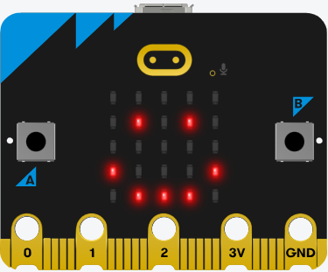
Scenario
I want to press a button for a number of times, then I want my microbit to behave in a specific way.
Here’s an example from Grok:
count = 0
while True:
if button_a.was_pressed():
count += 1
if button_b.was_pressed():
display.show(Image.HAPPY)
sleep(count * 1000)
display.clear()
Intro to microbits - Girl Power Camp

Slide 53

But still, why not just use is_pressed?
When using is_pressed, the music never stops!
This means that the count will keep incrementing until we’re not holding the button anymore
That’s cheating :(
Hence, we need to be able to define what a single press is
Intro to microbits - Girl Power Camp

Slide 54
Part 7: All together :)

Slide 55
Move a dot
Write a program that moves a dot horizontally.
3 steps:
Do we need a loop, an if statement, etc?
What changes happen to the display?
Sleep?
Intro to microbits - Girl Power Camp

Slide 56
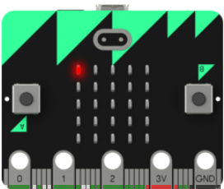
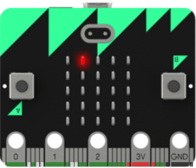
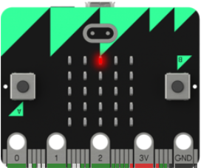
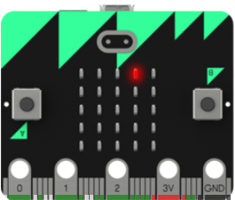
Move a dot
display.set_pixel(0,0,9)
display.set_pixel(1,0,9)
…
Set a pixel, wait
Clear
Set another pixel, wait
And so on and so forth
Intro to microbits - Girl Power Camp

Slide 57

Here’s the code
from microbit import *
x = 0
while True:
display.clear()
display.set_pixel(x, 0, 9)
sleep(1000)
x = x + 1
Intro to microbits - Girl Power Camp

Slide 58
One little fix
Notice that currently, when our program lights up the last pixel, it returns an error. This is because there is no coordinate x > 4, only the coordinates x = 0, 1, 2, 3, 4
How can we fix this?
We can add an if statement that checks if x > 4, and if so, reset x to 0!
Try doing that now!
Intro to microbits - Girl Power Camp

Slide 59

Grok Academy
This workshop has been created based on the BBC micro:bit Crash Course on Grok Academy
Check it out here:
https://groklearning.com/learn/microbit-crash-course/1/0/?ignore_lc=true

Slide 60
We used python to program a microbit, but the language is used to do a lot more!
Web Development
Data Analysis and Visualisation
Machine Learning and AI
Natural Language Processing
And much more
Intro to microbits - Girl Power Camp

Slide 61
Thank you and good luck!

